Slide 1

The Traveling Salesman Problem and Its Application in Google Maps Using QR-Tools

Slide 2
Introduction to Travelling Salesman Problem
Travelling Salesman Problem is based on a real life scenario, where a salesman from a company has to start from his own city and visit all the assigned cities exactly once and return to his home till the end of the day
The exact problem statement goes like this, "Given a set of cities and distance between every pair of cities, the problem is to find the shortest possible route that visits every city exactly once and returns to the starting point."
There are two important things to be cleared about in this problem statement, Visit every city exactly once and Cover the shortest path

Slide 3

Travelling Salesman Dynamic Programming Algorithm
Let us consider a graph G = (V,E), where V is a set of cities and E is
a set of weighted edges. An edge e(u, v) represents that
vertices u and v are connected. Distance between
vertex u and v is d(u, v), which should be non-negative.
Suppose we have started at city 1 and after visiting some cities now
we are in city j. Hence, this is a partial tour. We certainly need to
know j, since this will determine which cities are most convenient
to visit next. We also need to know all the cities visited so far, so
that we don't repeat any of them. Hence, this is an appropriate
sub-problem.

Slide 4

Time & Space Complexity
There are at the most 2^{n}.n sub-problems and each one takes linear time to solve. Therefore, the total running time is O(2^{n}.n²).
The worst case space complexity for the same is O(N²). The space complexity for the DFS is O(N). ∙ Hence space complexity of this algorithm is O(N²).

Slide 5
EXAMPLE
The goal is to find the shortest route that visits each city exactly once and returns to the starting point.
Step 1: Choose a starting city. Without loss of generality, let’s start with City 1.
Step 2: Generate all possible permutations of the remaining cities. For 4 cities, there are (3! = 6) permutations:
City 1 → City 2 → City 3 → City 4 → City 1
City 1 → City 2 → City 4 → City 3 → City 1
City 1 → City 3 → City 2 → City 4 → City 1
City 1 → City 3 → City 4 → City 2 → City 1
City 1 → City 4 → City 2 → City 3 → City 1
City 1 → City 4 → City 3 → City 2 → City 1
Step 3: Calculate the total distance for each permutation:
(10 + 35 + 30 + 20 = 95)
(10 + 25 + 30 + 15 = 80)
(15 + 35 + 25 + 20 = 95)
(15 + 30 + 35 + 10 = 90)
(20 + 25 + 35 + 15 = 95)
(20 + 30 + 35 + 10 = 95)
Step 4: Select the permutation with the minimum total distance. In this case, the second permutation has the shortest route with a total distance of 80.
So, the solution to this TSP instance is the route: City 1 → City 2 → City 4 → City 3 → City 1, with a minimum total distance of 80 units.

Slide 6

Code
#include <bits/stdc++.h>
using namespace std;
// Number of vertices in the
graph #define V 5
// Dynamic array to store the final
answer vector<int> final_ans;
int minimum_key(int key[], bool mstSet[])
{
int min = INT_MAX, min_index;
for (int v = 0; v < V; v++)
if (mstSet[v] == false && key[v] < min)
min = key[v], min_index = v;
return min_index;}
vector<vector<int>> MST(int parent[], int graph[V][V])
{
vector<vector<int>> v;
for (int i = 1; i < V; i++)
{
vector<int> p;
p.push_back(parent[i])
; p.push_back(i);
v.push_back(p);
p.clear();
}
return v;
}
// getting the Minimum Spanning Tree from the given graph// using Prim's Algorithm
vector<vector<int>> primMST(int graph[V][V])
{
int parent[V];
int key[V];
// to keep track of vertices already in MST
bool mstSet[V];
// initializing key value to INFINITE & false for all mstSet
for (int i = 0; i < V; i++)
key[i] = INT_MAX, mstSet[i] = false;
// picking up the first vertex and assigning it to
0 key[0] = 0;
parent[0] = -1;
// The Loop
for (int count = 0; count < V - 1; count++)
{
// checking and updating values wrt minimum
key int u = minimum_key(key, mstSet);
mstSet[u] = true;
for (int v = 0; v < V; v++)
if (graph[u][v] && mstSet[v] == false && graph[u][v] <
key[v]) parent[v] = u, key[v] = graph[u][v];
}
vector<vector<int>> v; v
= MST(parent, graph);
return v;
}
// getting the preorder walk of the MST using DFS
void DFS(int** edges_list,int num_nodes,int
starting_vertex,bool* visited_nodes) {
// adding the node to final answer
final_ans.push_back(starting_vertex);
// checking the visited status
visited_nodes[starting_vertex] = true;
// using a recursive call
for(int i=0;i<num_nodes;i++)
{

Slide 7
if(i==starting_vertex)
{
continue;
}
if(edges_list[starting_vertex][i]==1)
{
if(visited_nodes[i])
{
continue;
}
DFS(edges_list,num_nodes,i,visited_nodes)
; }}}
int main(){// initial graph
int graph[V][V] = { { 0, 10, 18, 40, 20
}, { 10, 0, 35, 15, 12 },
{ 18, 35, 0, 25, 25 },
{ 40, 15, 25, 0, 30 },
{ 20, 13, 25, 30, 0 } };
vector<vector<int>> v;
// getting the output as
MST v = primMST(graph);
// creating a dynamic matrix
int** edges_list = new int*[V];
for(int i=0;i<V;i++){
edges_list[i] = new int[V];
for(int j=0;j<V;j++)
{
edges_list[i][j] = 0;
}
}
// setting up MST as adjacency matrix
for(int i=0;i<v.size();i++)
{
int first_node = v[i][0]; int
second_node = v[i][1];
edges_list[first_node][second_node]
= 1;
edges_list[second_node][first_node] =
1; }
// a checker function for the DFS
bool* visited_nodes = new bool[V];
for(int i=0;i<V;i++)
{
bool visited_node;
visited_nodes[i] = false;
}
//performing DFS
DFS(edges_list,V,0,visited_nodes);
// adding the source node to the
path
final_ans.push_back(final_ans[0]);
// printing the path
cout<<"Optmial Path to travel: ";
for(int i=0;i<final_ans.size();i++){
cout << final_ans[i] << "-";}
return 0;
}

Slide 8
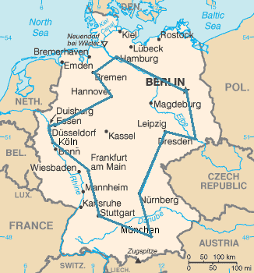
Google Maps
Google Maps can address a problem similar to the Traveling Salesman
Problem (TSP) by using its Directions API, which includes an option
called (optimizeWaypoints). This feature attempts to reorder waypoints
for the most efficient route, which is a practical application of TSP
principles.
For more complex routing problems, Google offers OR-Tools, an open
source suite of optimization tools that includes solvers for various
problems, including TSP. OR-Tools can handle both symmetric (where the
distance from A to B is the same as from B to A) and asymmetric travel
scenarios. It can also manage more complex versions of TSP, like those
with time windows or prize-collecting objectives
This Photo by Unknown author is licensed under CC BY-SA.

Slide 9

Google Maps and TSP
Real-World Application of TSP: The Traveling Salesman Problem (TSP) is crucial for route optimization in mapping services. It helps determine the most efficient path that visits all specified locations once, minimizing travel time or distance, which is essential for logistics, delivery services, and navigation apps.
Google’s OR-Tools: Google’s OR-Tools is a comprehensive suite designed to tackle complex optimization problems. It includes solvers for TSP, enabling users to find the shortest possible route that visits a series of locations, which is invaluable for planning and route management in various industries.

Slide 10
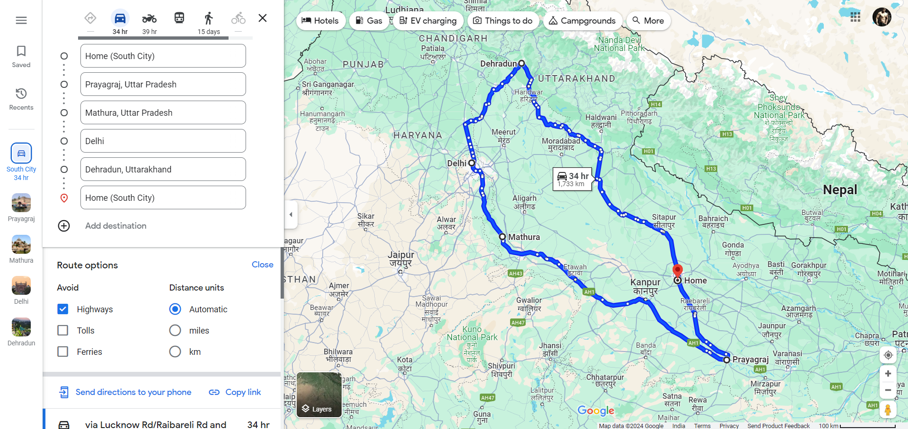

Slide 11
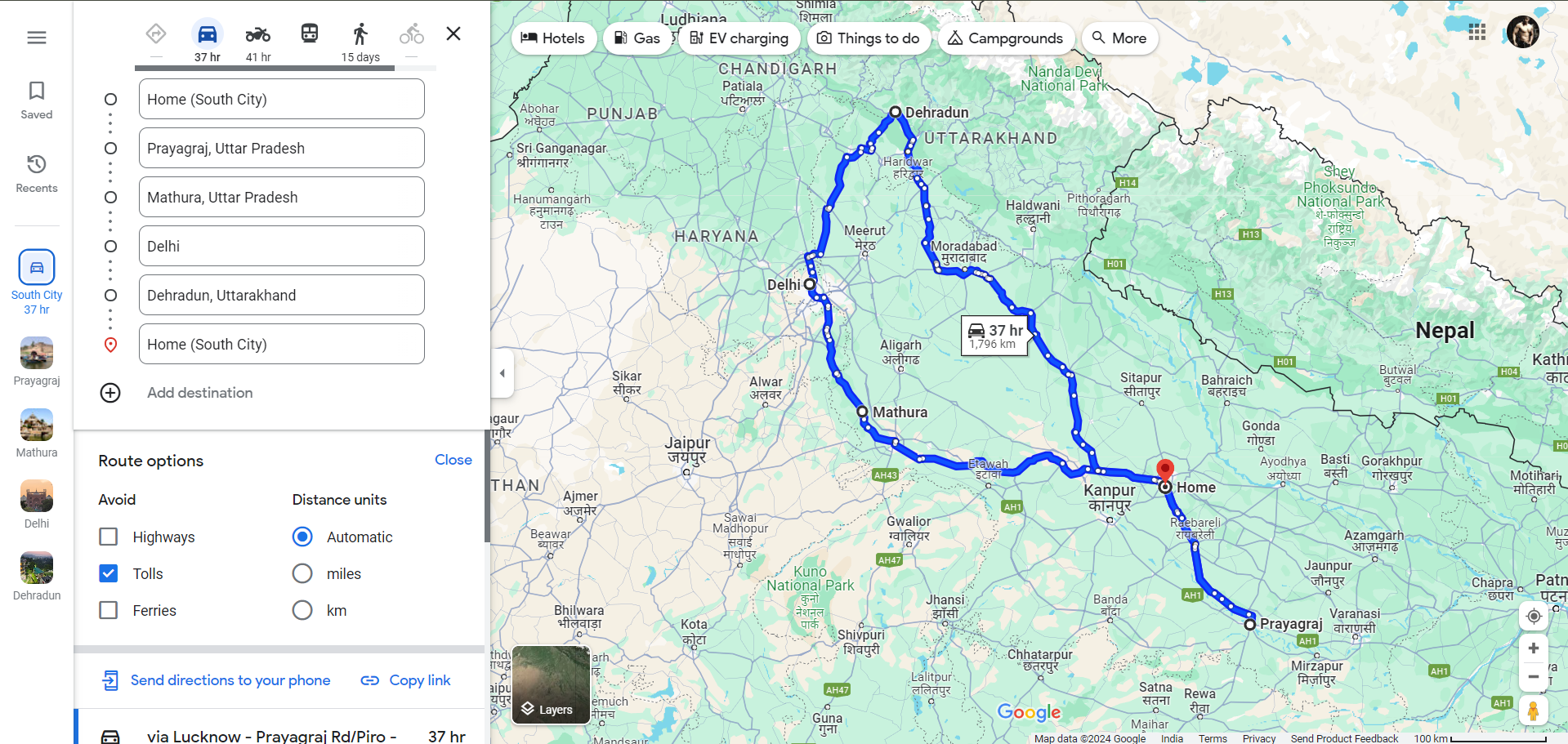

Slide 12
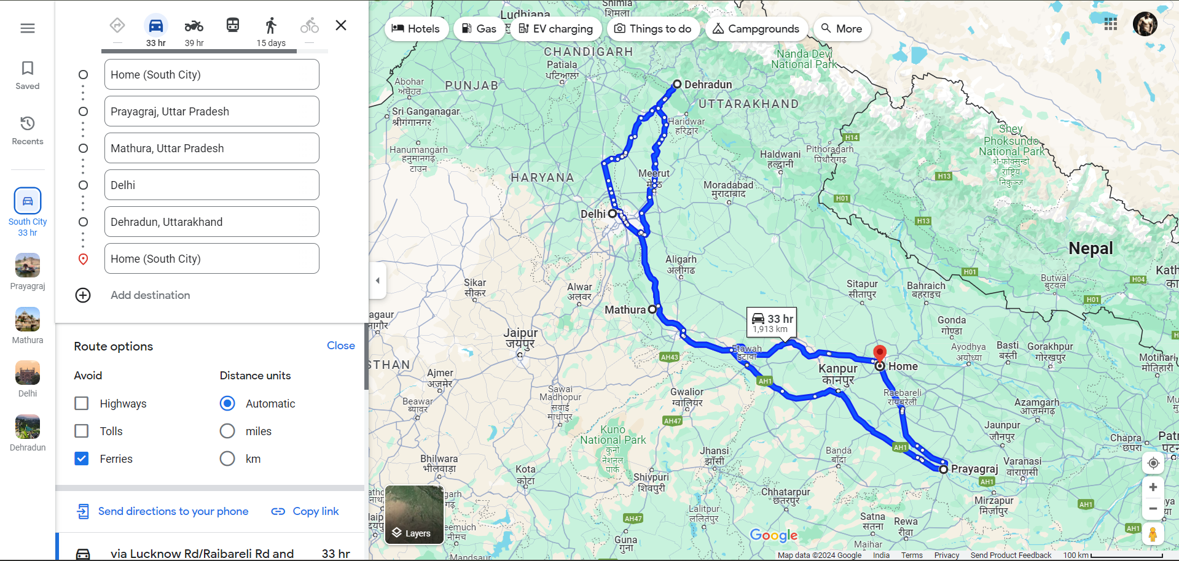

Slide 13

Conclusion
The Traveling Salesman Problem (TSP) is a classic optimization challenge that seeks the shortest possible route to visit a set of cities and return to the origin. It’s a cornerstone of combinatorial optimization and is known for being NP-hard, meaning there’s no known polynomial-time solution for large instances¹. TSP has practical implications in various fields such as logistics, scheduling, and routing problems. For example, it can optimize delivery routes, thereby reducing costs and improving efficiency
The future of TSP solutions is leaning towards data-driven and service-oriented platforms. These platforms aim to ensure reliable connections, efficient data transmission, and flexible data processing. The focus is on creating robust, high-performance, and maintainable data infrastructures to support the growing complexity and demands of applications like automotive connectivity³. Additionally, advancements in algorithms and computational power may lead to more efficient heuristic methods for solving TSP, even as the problem sizes grow.

Slide 14

Thank You

